Slide 1
ERKIN A‘ZAMOVNING “TANHO QAYIQ” DRAMASI
11-sinf Adabiyot

Slide 2
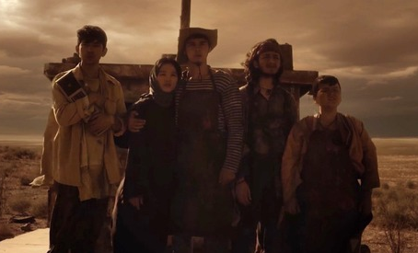
Asardagi xayrixoh timsollarni ajrating
Orol bobo
Tilovbergan
Jumaboy
Amet
Genjamurod

Slide 3
Orol boboning oila a‘zolarini izohlang
Orol bobo
Oykumush...
Gulxadicha...
Qalimbet...

Slide 4
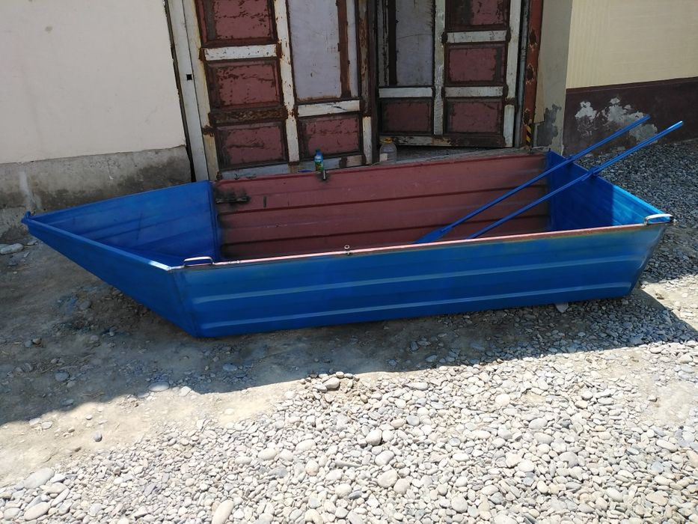
1-topshiriq
Dramada qayiq nimaning ramzi deb o‘ylaysiz?
____________________________________________________________________________________________________________________________________________________________________________________________________________________________________________________________________________________________________________________________
____________________________________________________________________________________________________________________________________________________________________________________________________________________________________________________________________________________________________________________________

Slide 5
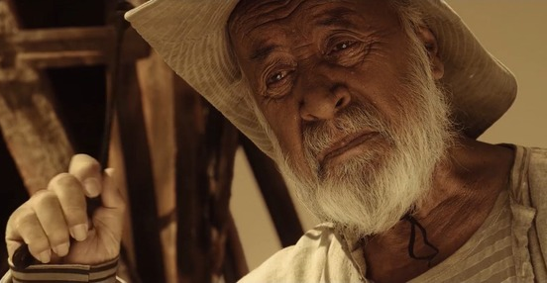
2-topshiriq
Orol boboning fazilatlarini klaster metodi bo‘yicha izohlang
Orol bobo

Slide 6
Orol bobo
dono
halol
mehnatkash
qat‘iyatli
mohir usta
vatanparvar

Slide 7
3-topshiriq
Orol bobo farzandlariga xos sifatlarga baho bering.
Qalimbet
Tadbirkor
_______
o‘z foydasini o‘ylovchi
________
Gulxadicha
Deputat
________
xudbin
_______

Slide 8
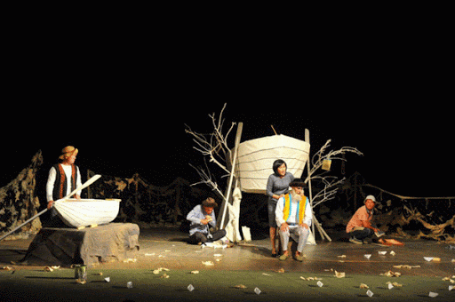
4-topshiriq
Orol boboning haj ziyorati haqidagi fikrlarini matndan topib o‘qing, tahlil qiling.
____________________________________________________________________________________________________________________________________________________________________________________________________________________________________________________________________________________________________________________________
____________________________________________________________________________________________________________________________________________________________________________________________________________________________________________________________________________________________________________________________

Slide 9
5-topshiriq
Har yili hajga boradigan O‘tagan maxsum bilan Orol boboni VENN diagrammasi metodi orqali tavsiflang
O‘taganboy:
doim foydani ko‘zlovchi
________________
_______________
Orol bobo:
boriga shukr qiluvchi
______________
__________

Slide 10
6-topshiriq
Orol bobo farzandlariga qanday baho berasiz? “Nima deb o‘ylaysiz” texnologiyasidan foydalaning.
Qalimbet
Nabiralarini bobosiga ko‘rsatmaydi...
Markazdan chiroyli uy olib beradi...
Hajga yubormoqchi bo‘ladi...
Gulxadicha
Otasiga g‘amxo‘rlik qiladi...
Ukol olishga ko‘ndiradi…
Uyiga olib ketadi...

Slide 11
7-topshiriq
Orol boboning vasiyati nimadan iborat edi?
_____________________________________________________________
So‘nggi vasiyatni amalga oshirishga bag‘ishlangan yana qanday asarlarni bilasiz?
____________________________________________________________
Asardan kimsasiz qolgan Orol haqidagi tasvirlarni topib o‘qing.
____________________________________________________________
Orol boboning ozuqasi nima edi? Uni qanday topar edi?
____________________________________________________________
Shogirdlarining o‘ylab topgan g‘oyasini Siz to‘g‘ri deb o‘ylaysizmi?
____________________________________________________________
Orol bobo shogirdi Ametning otasi kim?
____________________________________________________________
U o‘g‘lini qayerga yuboradi?
____________________________________________________________

Slide 12
7-topshiriq
Siz Ametning o‘rnida bo‘lsangiz qaysi ishni tanlardingiz?
_____________________________________________________________________________Kasb-hunar egallab, uning ustasi bo‘lish muhimmi, ko‘proq pul topib yurishnimi?
_____________________________________________________________________________Asarda ekologiyaga doir qanday fojiani payqadingiz?
_____________________________________________________________________________Odamlar o‘z uylarini tashlab ketishiga sabab bo‘lgan omillarni izohlang
_____________________________________________________________________________Orol boboning sadoqatini qanday baholaysiz?
_____________________________________________________________________________O‘z hunarini shogirdlariga o‘rgatayotgan ustaning ma‘naviy qiyofasini tasvirlang
_____________________________________________________________________________Dramada sizga ma‘qul bo‘lgan qahramonlarni ko‘rsating.
________________________________________________________________________________Yoqmagan timsollarni ham izohlab bering.
_____________________________________________________________________________

Slide 13
“Kim topqir?” texnologiyasi
Asardagi barcha timsollarni quyidagi shakllarga joylashtiring.

Slide 14
“Kim topqir?” texnologiyasi
Javobingizni tekshirib oling.
qum
baliq
suv
oqchorloq
qayiq
eshkak

Slide 15

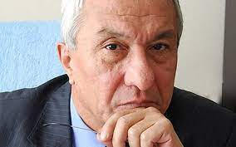
UYGA VAZIFA
1.“Ekologiya va biz” mavzusida ilmiy matn tayyorlang.Unda geografiyaga oid bilimlarngizdan foydalaning.
2. Asr fojiasiga aylangan Orol dengizi muammosi haqida mulohaza bildiring.

Slide 16
E‘TIBORINGIZ UCHUN
RAHMAT

